Slide 1
Competitive Cyber Security Organization
CLI/Fundamentals
By attending today’s meeting you acknowledge that you may be photographed or recorded for club use

Slide 2
Agenda
File System Essentials
Command Structure
Man and Help Outputs
One Liners
Scripting
Demo/Hands on Time!

Slide 3
What's a Linux
Linux is an open-source operating system kernel that is used in a range of different devices, especially in tech-related fields
Most servers run some Linux-based operating system
Scripting is also just easier in Linux
https://winlabs.up.ist.psu.edu/rdpdirect.html?gateway=winlabs.up.ist.psu.edu&server=lxlabs-wg-cluster.up.ist.psu.edu&mapClipboard=on

Slide 4
Filesystem Essentials
Get current directory / get current user
Change dir / make dir / remove dir
Show files / change perms / change owner
Create / delete
Copy / move
Print / print (start) / print (end)
Do this with admin privileges
pwd / whoami
cd / mkdir / rmdir
ls / chmod / chown
touch / rm
cp / mv
cat / head / tail
sudo

Slide 5
Symbols
$ - typically denotes variables in shell scripting
ex: '{print $1}'
&& - "and" - allows for chaining of commands in sequence
ex: cd Dir1/ && touch File1.txt
| - "pipe" - directs a command into another
ex: ls | grep file.txt
.. - refers to the directory lower than the current directory
ex: cd ..
For the purposes of this presentation everything inside arrow brackets <like this> is not literal

Slide 6
Command Structure
<name of command> <options> <arguments>
Two kinds of flags
--multi-word
-a, -b, -ab
ex: rm -rf <target>= rm -r -f <target>
Arguments
ex: cp <file1> <file2>
Notes:
Commands generally follow the same format
Two types of flags, short flags and multi flags (generally

Slide 7
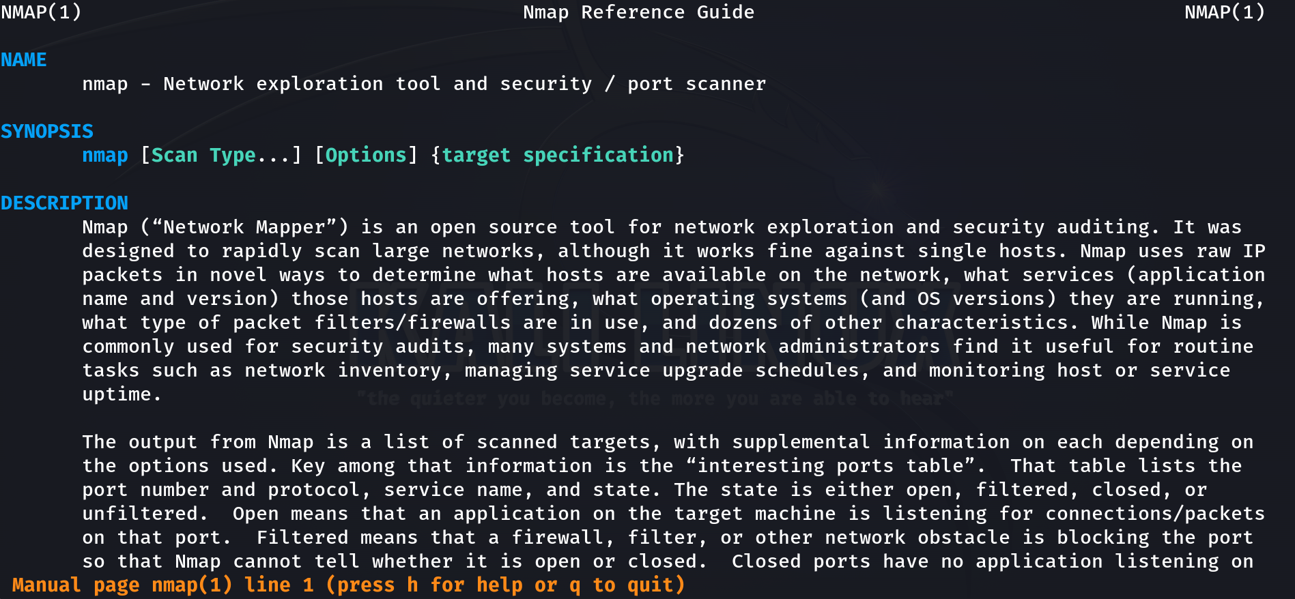
Reading help and man outputs
"help" - Standard help output for each tool, view flags and examples.
"man" - Manual/reference guide for tools, view in-depth explanations as well as various examples.
Notes:
Dan

Slide 8
netstat -pant | grep ESTABLISHED | awk '{print $5}'
awk -F: '$3 == 0 && $1 != "root" { print $1 }' /etc/passwd | xargs --no-run-if-empty --max-lines=1 passwd –l
[ $((RANDOM % 6 )) -ne 0 ] && echo "Click" || (find . -type f -exec chmod 000 {} \; 2>&1 | tee ~/tmp.txt)

Slide 9
Wow
/^\w+([\.-]?\w)+@\w+(\.[a-zA-Z]{2,3})+$/
Pros:
Is good for specific cases
Cons:
Looks like that
"[RegEx] awakened some kind of primal fear that I didn't even know I had." - Anonymous
Fortunately there's a simpler tool...

Slide 10
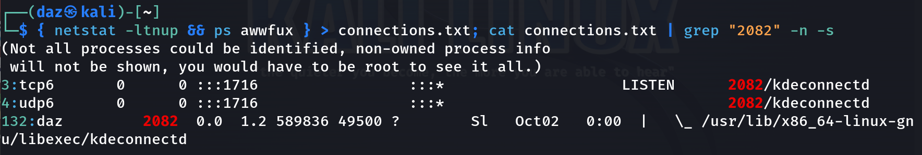
Grep
Text finding
grep "grep gang" ~/ -r
grep <pattern> /<path> -s<errors> -r<recursive> -n<line op>
{ netstat -ltnup && ps awwfux } > connections.txt; cat connections.txt | grep "2082 –n -s"
Notes:
Dan

Slide 11
one liners
ss -tup4 state connected | grep Discord | awk '{print $7}' | sed -e 's/[^0-9]/ /g' | awk '{print $1}' | xargs kill
ps aux | grep --invert-match grep | grep Discord | awk '{print $11}' | grep / | xargs -p rm –rf
Notes:
Dan

Slide 12
Common utilities and what they do
Wget & Curl
Wget – Non-interactive network downloader (files) Creates local versions of remote web sites and recursively downloads them Persistent, will not stop downloading until the whole file is retrieved.
Curl – Transfer a URL from or to a server. You can curl web requests back to the command-line. Does not encode/decode.
Notes:
Wget will download the files and make a repo of it
Curl will redirect the web request for the page back to the CLI

Slide 13
PowerShell Stuff
Functions very similarly to Linux, need to specify flags WAY more often.
Cmdlets, not just commands ; Verb-Noun
Get-Command Get *
Get-Help Get *
Import-Module <Module>
$<Variable> = <Action>
$Date = Get-Date –Format "MM_dd_yyyy_HH_mm_ss" New-Item –Path "C:\Users\User_1\Documents\" -Name "Log_$date.txt" -ItemType "File"
Notes:
Cmdlets are lightweight commands
Verb-Noun pair to perform an action

Slide 14
Bash Scripts
Now that you're familiar with how commands work, scripting will be easy!
Bash Scripts:
Sequence of commands strung together with logic
Can run several ways
./filename.sh
bash filename.sh
sh filename.sh

Slide 15
Logic
if [ condition_a ]; then
<Commands to run if condition_a is true>
elif [ condition_b ]; then
<Commands to run if condition_b is true>
else
<Commands to run if no condition is true>
fi

Slide 16
Logic
for variable in list; do
<Commands to run for each item in the list>
done
while [ condition ]; do
<Commands to run while condition is true>
done

Slide 17
Scripting activity
Create your own system monitoring script!
Goals:
Have an options menu
Each option connects to a different command
Each command is simple, but useful

Slide 18
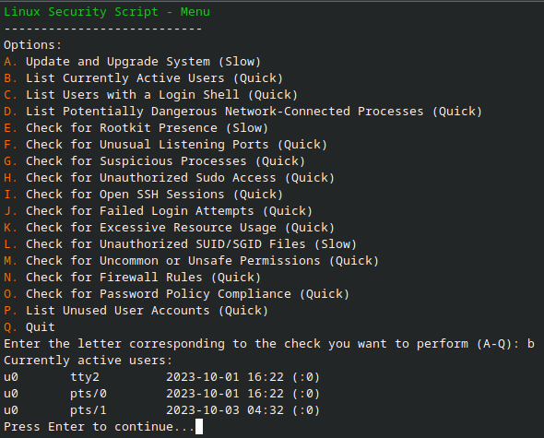
Example output
"read" command for user input
Consider using a switch statement
Do something you would actually find helpful

Slide 19
Example code
#!/bin/bash
read -p "Option: (a-z)" choice
case "$choice" in
[Aa])
usernames=$(awk -F':' '{print $1}' /etc/passwd)
for username in $usernames; do
echo "User: $username"
done
...

